Slide 1

INTRODUCTION TO AI

Slide 2
WHAT IS AI ?
Artificial intelligence (AI) is an area of computer science that emphasizes the creation of intelligent machines that work and react like humans.
Machine which take sensible decisions like humans without any external supervision
Science ? Technology ? Subject ?
Computers are AI ?

Slide 3
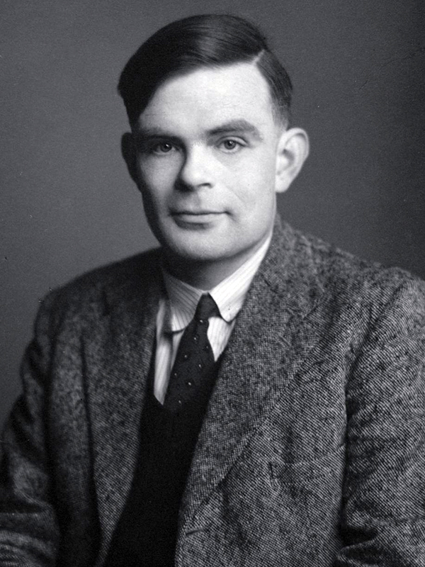

WHERE IT STARTED ?
TURING TEST - A test distinguish whether its a human or a computer .
Enigma - Imitation Game

Slide 4
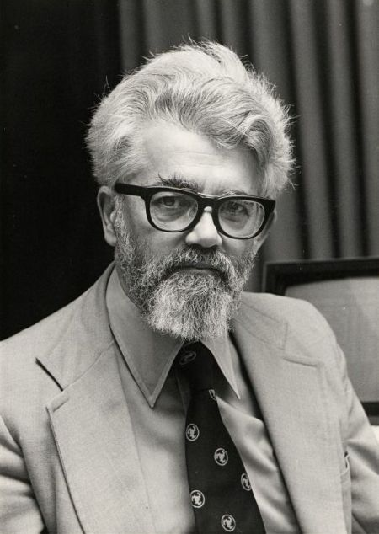
John McCarthy - Coined AI
Father of AI
1956 Dartmouth Conference
"every aspect of learning or any other feature of intelligence can in principle be so precisely described that a machine can be made to simulate it."

Slide 5
MAIN TOPICS OF AI
Prediction
Classification
Knowledge Representation
Natural Language Processing
Interacting with Environment ( Speech Recognition , Computer Vision )
Expert Systems

Slide 6
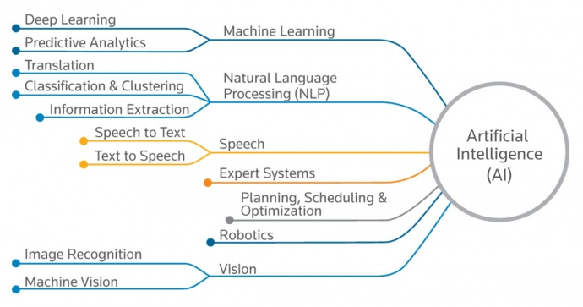

Slide 7

AI vs ML vs DL

Slide 8
What is Machine Learning?
It is the technique of using Statistical Models to give computers the ability to learn from data.
The basic premise of machine learning is to build algorithms that can receive input data and use statistical analysis to predict an output while updating outputs as new data becomes available.
"A computer program is said to learn from experience E with respect to some class of tasks T and performance measure P if its performance at tasks in T, as measured by P, improves with experience E." - Tom Mitchel
Data is the new Oil.

Slide 9
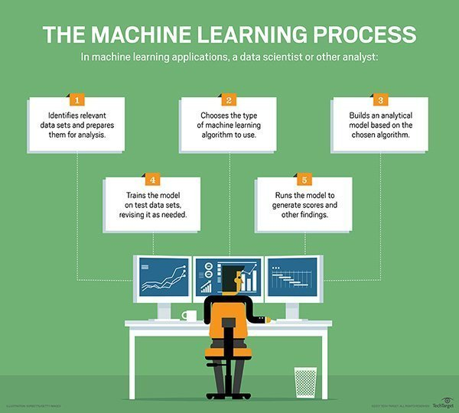

Slide 10
Types of Machine Learning
Supervised Learning
Regression
Classification
Unsupervised Learning
Clustering
Reinforcement Learning
Agent -Environment interactions.
Predicting Stock price, identifying the type of customer.
Grouping similar customers.
AI playing games, Self Driving Cars.

Slide 11
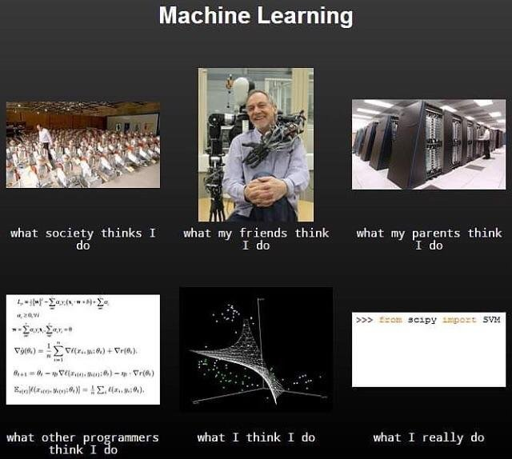

Slide 12
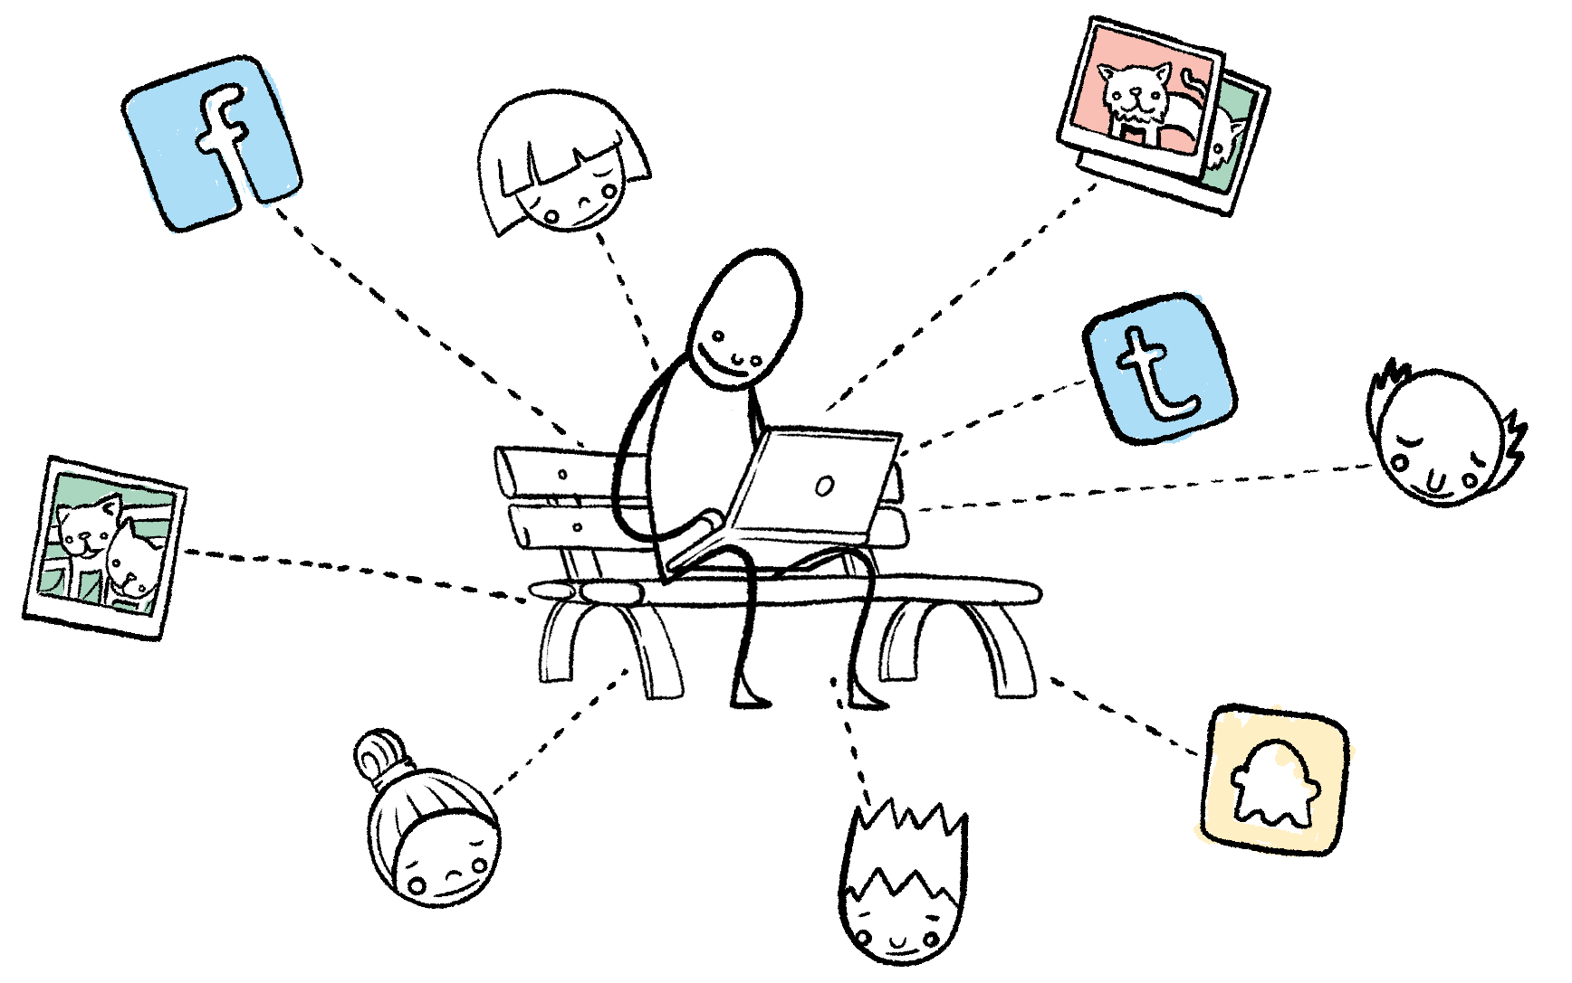
Big Data and Machine Learning
Advent of Big data gave us the power to train complex models.
Thus began the rise of Deep Learning.
Deep Learning gave us the power to do complex tasks like image recognition, etc.

Slide 13
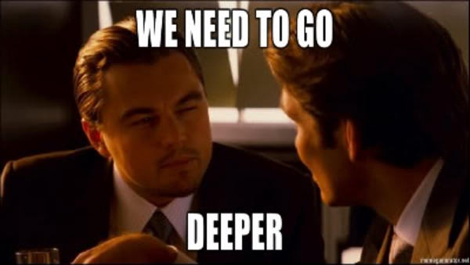
Deep Learning
Mimicking the Human brain.
Neural Networks
GPU
Too much of Data
Auto Feature Selection

Slide 14

How does this magic work?

Slide 15
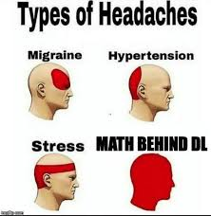
Math behind AI
Linear Algebra
Calculus
Statistics
Probability Theory
Optimization Theory

Slide 16
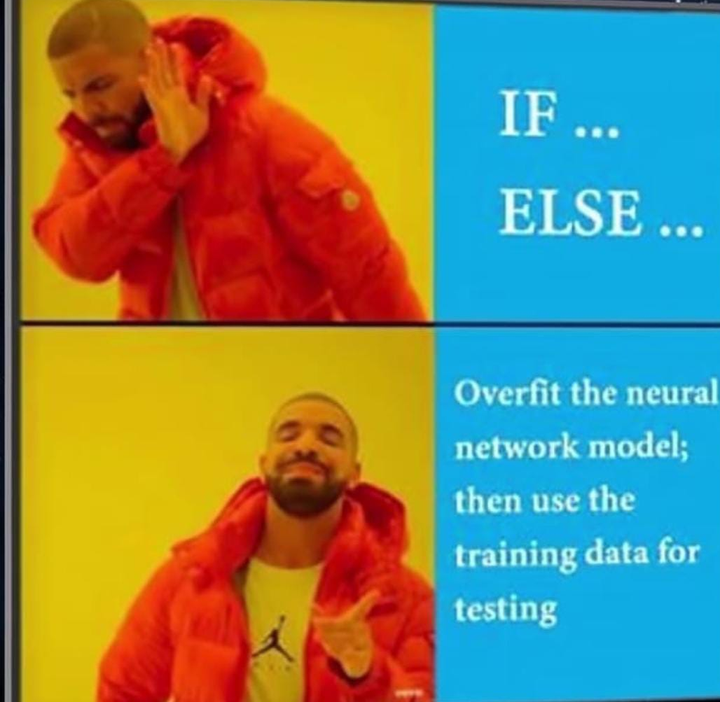
AI: What's Hype and What's Real
Problem of over fitting (mug up)
Wrong idea of AI in people.
Fear of AI

Slide 17

Programming Languages for AI
Python
R
JavaScript
C++
Java
Matlab
LISP
Prolog

Slide 18
Tools For AI
Tensorflow
Microsoft CNTK
Keras
PyTorch
Caffe
Scikit-Learn
MxNet
Apache Spark
Anaconda
Jupyter Notebook
Google Colab
Kaggle

Slide 19
Learning Platforms for AI
Coursera
Machine Learning Crash Course Google
IBM Cognitive Class
NPTEL
Edx
Udacity
YouTube channels like Siraj Raval, Sentdex.
Blogs
Social Media

Slide 20
Advantages
More efficient use of labour resources - hiring robots for some jobs
Faster information processing and decision-making
Reduction of errors
Objectivity - no influence of personal connections on the decision making process
Increased personalization of the information received, e. g. The education system, advertising
Exploration capacity (e. g. going outside the globe)

Slide 21
Disadvantages
Lack of knowledge about the foundation on which the decision was made
Misuse of AI
No data, no power.
Computationally limitations
Threat to Human kind?

Slide 23
Prepare for the AI era...

